Slide 1
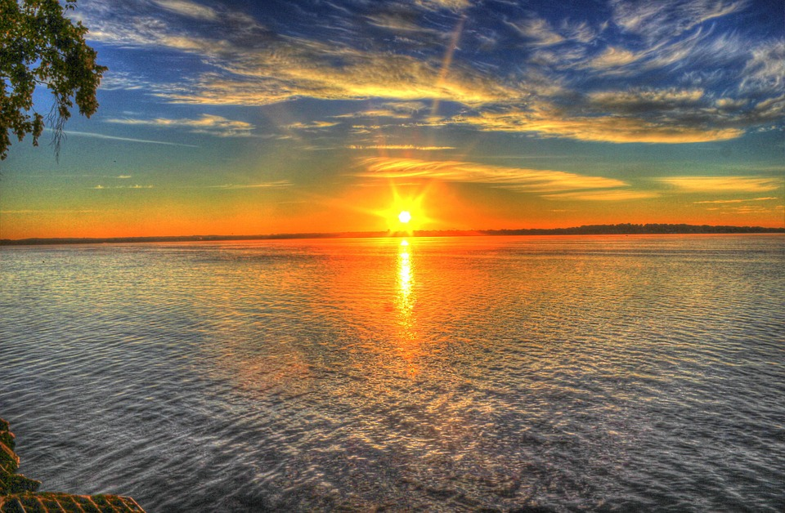
Этот прекрасный мир

Slide 6
Используемые интернет-ресурсы
Закат солнца: https://pixabay.com/ru/%D0%B2%D0%BE%D1%81%D1%85%D0%BE%D0%B4-%D0%BE%D0%B7%D0%B5%D1%80%D0%BE-%D0%B2%D0%BE%D0%B4%D1%8B-%D0%B6%D0%B8%D0%B2%D0%BE%D0%BF%D0%B8%D1%81%D0%BD%D1%8B%D0%B9-182302/
Зимующая птица: https://pixabay.com/ru/%D1%81%D0%BE%D0%B9%D0%BA%D0%B0-%D0%BF%D1%82%D0%B8%D1%86%D0%B0-%D0%BA%D1%83%D0%BD%D0%B0%D1%80-%D0%B7%D0%B8%D0%BC%D0%B0-548381/
Весенние тюльпаны: https://pixabay.com/ru/%D1%82%D1%8E%D0%BB%D1%8C%D0%BF%D0%B0%D0%BD-%D0%B6%D0%B5%D0%BB%D1%82%D1%8B%D0%B9-%D1%8F%D1%80%D0%BA%D0%B8%D0%B9-%D0%B2%D0%B5%D1%81%D0%BD%D0%B0-690320/

Slide 7
Олень в осеннем лесу: https://pixabay.com/ru/%D0%BB%D0%B0%D0%BD%D1%8C-%D0%B4%D0%B0%D0%BC%D0%B0-%D0%B4%D0%B0%D0%BC%D0%B0-%D0%BC%D1%83%D0%B6%D1%87%D0%B8%D0%BD%D1%8B-%D0%B4%D0%B8%D0%BA%D0%B8%D0%B5-984573/
Бабочка: https://pixabay.com/ru/%D0%B1%D0%B0%D0%B1%D0%BE%D1%87%D0%BA%D0%B0-%D0%BB%D0%B0%D1%81%D1%82%D0%BE%D1%87%D0%BA%D0%B8%D0%BD-%D1%85%D0%B2%D0%BE%D1%81%D1%82-%D0%BC%D0%B0%D1%85%D0%B0%D0%BE%D0%BD-491166/

